Slide 1
Drawing Lewis Dot Diagrams

Slide 2
The Steps
Draw a skeletal structure
Sum the valence electrons
Fill in the skeletal structure with dots and bars to represent electrons
Make adjustments as appropriate
All atoms need octets (with few exceptions) hydrogens need duets.

Slide 3
Draw the skeletal structure
Connect covalently bonded atoms with single bonds ―
Example structures:
O₂ O―O O₃ O―O―O H₂O H―O―H
Hydrogen atoms are always terminal—never in the middle.
so H―H―O is not allowed. N₂H₄ H―N―N―H
│ │
H H

Slide 4
Draw the skeletal structure
Place the least electronegative atom in the middle. See Table.
HCN H―C―N NO₂ O―N―O NF₃ F―N―F
│
F
H₂SO₃ H―O―S―O―H N₂O N―N―O
│
O
The structure with the smallest (closest to zero) formal charges is preferred.
c. supercedes b. b. is usually adequate, but see later discussion.

Slide 5
1A
H 2.1 | 2A |  |  |  |  |  |  |  |  |  |  | 3A | 4A | 5A | 6A | 7A | 8A
Li 1.0 | Be 1.5 |  |  |  |  |  |  |  |  |  |  | B 2.0 | C 2.5 | N 3.0 | O 3.5 | F 4.0
Na 1.0 | Mg 1.2 | 3B | 4B | 5B | 6B | 7B | ⎡ | 8B | ⎤ | 1B | 2B | Al 1.5 | Si 1.8 | P 2.1 | S 2.5 | Cl 3.0
K 0.9 | Ca 1.0 | Sc 1.3 | Ti 1.4 | V 1.5 | Cr 1.6 | Mn 1.6 | Fe 1.7 | Co 1.7 | Ni 1.8 | Cu 1.8 | Zn 1.6 | Ga 1.7 | Ge 1.9 | As 2.1 | Se 2.4 | Br 2.8 | Kr 3.0
Rb 0.9 | Sr 1.0 | Y 1.2 | Zr 1.3 | Nb 1.5 | Mo 1.6 | Tc 1.7 | Ru 1.8 | Rh 1.8 | Pd 1.8 | Ag 1.6 | Cd 1.6 | In 1.6 | Sn 1.8 | Sb 1.9 | Te 2.1 | I 2.5 | Xe 2.6
Cs 0.8 | Ba 1.0 | La 1.1 | Hf 1.3 | Ta 1.4 | W 1.5 | Re 1.7 | Os 1.9 | Ir 1.9 | Pt 1.8 | Au 1.9 | Hg 1.7 | Tl 1.6 | Pb 1.7 | Bi 1.8 | Po 1.9 | At 2.1
Fr 0.8 | Ra 1.0 | Ac 1.1
Electronegativities of the Elements
Electronegativity is the relative ability of an atom to attract electrons to itself in a chemical bond.

Slide 6
2. Sum the Valence Electrons
Sum the valence electrons for all atoms.
H₂O 1x2 + 6 = 8 H is in column 1A O is in column 6A
NF₃ 5 + 7x3 = 26 N is in column 5A F is in column 7A
H₂SO₃ 1x2 + 6 + 6x3 = 26
CO₃²⁻ 4 + 6x3 + 2 = 24 add electron(s) for negative charge
NH₄⁺ 5 + 1x4 − 1 = 8 subtract electron(s) for positive charge

Slide 7
Form octets for all atoms (duets for H)
An octet is an arrangement of 8 electrons around an atom.
Each bond − counts as 2 electrons. Bonded pairs count for both atoms.
Each lone pair : counts as two electrons for just one atom.
A correctly drawn structure will already have a single bond (2 electrons) between neighboring atoms. Proceed by adding the remaining valence electrons to the structure as lone pairs until all atoms have octets. H will not have lone pairs. Each H will only have a single bond, H− (a duet).
H₂O has structure H−O−H with 8 electrons. Each bond already has 2 electrons, so add 4 more as lone pairs to O.
H− −H O has an octet.

Slide 8
Move electrons to form octets on all atoms.
O₂ has structure O−O and 2x6 valence electrons = 12
Add electrons : − The left O has an octet : − but not −
So 4.a. If there are not enough electrons to form octets on all atoms move pairs of electrons to form double and triple bonds to complete octets.
: − so = = represents a double bond
a sharing of 4 electrons

Slide 9
Move electrons to form octets
HCN has structure H−C−N and 1 + 4 + 5 = 10 valence electrons
Each − counts for 2 electrons so add 6 more.
H−C− : C has no octet so move 2 pairs of electrons to form a triple bond ≡
H−C≡N: A triple bond is a sharing of 6 electrons
so C has an octet −C≡ and N has an octet ≡N:
H has a duet H−

Slide 10
Formal Charges
Each atom in a molecule is assigned a charge, much in redox reactions each atom was assigned an oxidation number. There all atoms were assumed to be as ionic as possible. Oxygen was −2 and H was +1, etc.
In formal charges atoms are assumed to be a covalent as possible. The electrons in each covalent bond are divided equally between the bonded atoms. If two electrons are shared between two atoms each atom is assigned one electron. In double bonds each atom is assigned two electrons. Lone pair electrons are assigned completely to one atom. The number of electrons so assigned are compared to the valence electrons and a charge assigned accordingly.

Slide 11
Formal Charges
In HCN H−C≡N: electrons in bonds are divided equally
H−C≡N: H has 1 e⁻ 1 from the single bond with C C has 4 e⁻ 1 from the single bond e from ≡ N has 5 e⁻ 3 from ≡ and 2 from the lone pair
H has 1 electron in the molecule, it brought in 1 electron so it neither gained nor lost electrons. It has a formal charge of 0.
C has 4 e⁻, it brought in 4 e⁻. It has formal charge of 0
N has 5 e⁻, it brought in 5 e⁻. It has formal charge of 0

Slide 12
Formal Charges
If HCN were drawn with nitrogen in the middle H−N−C
The Lewis Dot Diagram would be: H−N≡C:
Now N would have 4 electrons (1 from − and 3 from ≡) It brought in 5 e⁻. So it lost one. Formally N has charge +1. Formal charges can also be determined by formula.
C has 5 e⁻, it brought in 4 e⁻. So formally C has a charge −1.
Often formal charges are written with the structures. H−C≡N: H−N≡C:
formal charges 0 0 0 0 +1 −1
This illustrates 1.c. The structure with the smallest formal charges is preferred.

Slide 13
Formal charges by formula
The formal charge of any atom in any covalent compound can be determined by formula:
Formal charge = valence electrons − bonds −lone pair electrons
H−C≡N: H−N≡C:
0 0 0 0 +1 −1
for H fc = 1−1 = 0 for H fc = 1−1 = 0
for C fc = 4−4 = 0 for N fc = 5−4 = +1
for N fc = 5−3−2 = 0 for C fc = 4−3−2 = −1

Slide 14
Formal Charges
Usually Step 1.b. Place the least electronegative atom in the middle
is sufficient to determine the correct skeletal structure—but not always. Consider HClO H−Cl−O by rule 1.b.
With 1 + 7 + 6 electrons = 14 leads to H− − :
with formal charges 0 +1 −1
Formal charges are better with the arrangement H− − :
with formal charges 0 0 0
This illustrates 1.c. The structure with the smallest formal charges is preferred.

Slide 15
Formal Charges
Rule 1.c for determining skeletal structures requires drawing more than one Lewis Dot Diagram, calculating formal charges, and comparing the all the structures to pick the appropriate skeletal structure.
The advantage of rule 1.b. is that the skeletal structure for the molecule is determined before any Lewis Dot Diagrams are drawn.
But if rule 1.b. results in a Lewis Dot Diagram without optimal formal charges, rule 1.c. should not be ignored, i.e., try other skeletal structures.

Slide 16
Resonance
6. Add resonance structures that have equivalent bonding patterns for the same skeletal structure (i.e., draw atoms in exactly identical patterns—only the electrons change places) Draw double arrows ( ↔ )between equivalent structures.
Draw a Lewis Dot diagram for O₃ O−O−O with 6x3 = 18 electrons
Step 3 : − − : apply step 4.b. = − : or : − =
formal charges 0 +1 −1 −1 +1 0
These structures are not exactly the same, even though one will rotate into the other. An oxygen on one end can be labeled. For example, a different isotope can be used O−O−O¹⁷.
Notice the formal charges are not identical, but they are equivalent. So both structures need to be drawn with ↔ between them.
= − : ↔ : − =

Slide 17
Resonance
So what does resonance mean? The molecule does not resonate.
Look at the average bond lengths on the next slide.
O−O single bond should be about 148 pm
and O=O double bond should be about 121 pm
So one of the structures = − : would have a short bond and a long bond.
But by measurement O₃ has both bonds the same length = 127.8 pm, which is longer than a double bond and shorter than the single bond.
The resonance structure indicates each bond is partly single bond and partly double bond.
= − : ↔ : − =

Slide 18
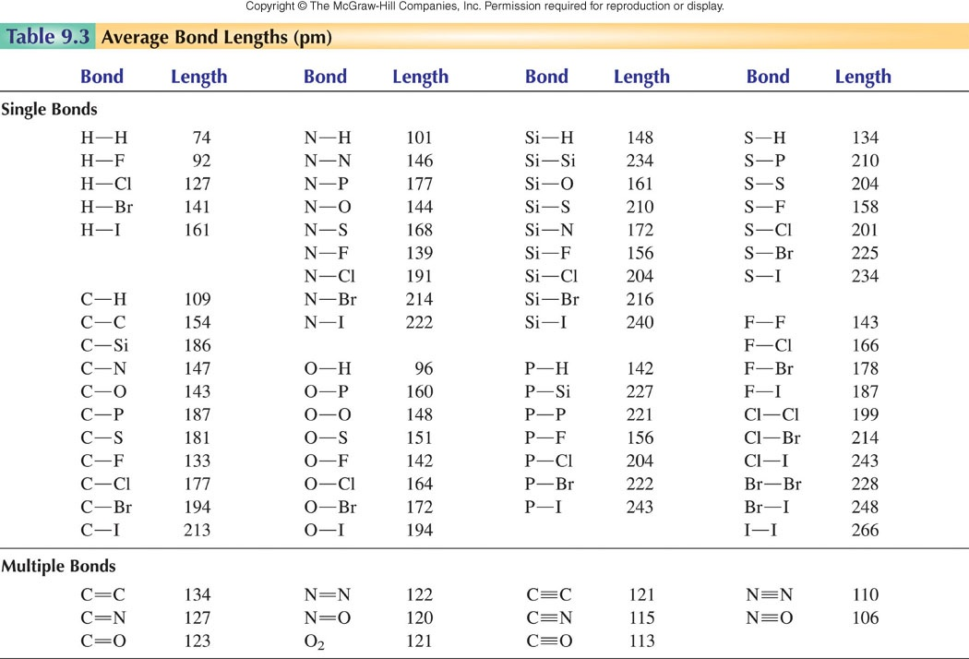

Slide 19
Bond Orders
A single bond has bond order 1
A double bond has bond order 2
A triple bond has bond order 3
So for H−C≡N:
Bond orders are 1 and 3
When there is resonance, the bond order is determined by averaging over the resonance structures.
For ozone the bond orders are: 1.5 = (2 + 1)/2 (double + single)
= − : ↔ : − =
and for the second bond 1.5 = (1 + 2)/2 for 2 resonance structures

Slide 20
Formal charges in resonance structures
Formal charges are also averaged over the resonance structures.
formal charges 0 +1 −1 −1 +1 0 for each structure
For ozone: = − : ↔ : − =
( 0 −1 ) /2 = −½ for left O
(+1 +1 ) /2 = +1 for middle O
(−1 +0) /2 = −½ for right O
Formal charges are −½ +1 −½ for ozone oxygens

Slide 21
Consider HNO₂
Draw a skeletal structure: H− −O H−O−N−O or H−N−O−O ? O
2. Sum the valence electrons: 1 + 5 + 6x2 = 18
3. Add electrons to structures to form octets: calculate formal charges
H− = 0 +1 0
: : −1
H− − : 0 +1−1
:O: 0
H− − =
0 0 0 0
H− = − :
0 +1 0 −1
This is obviously best. There is no reason to draw HNOO.
These 2 structures are not equivalent so no resonance.
Actual bond lengths are.
0.954 143.3 117.7 pm

