Slide 1
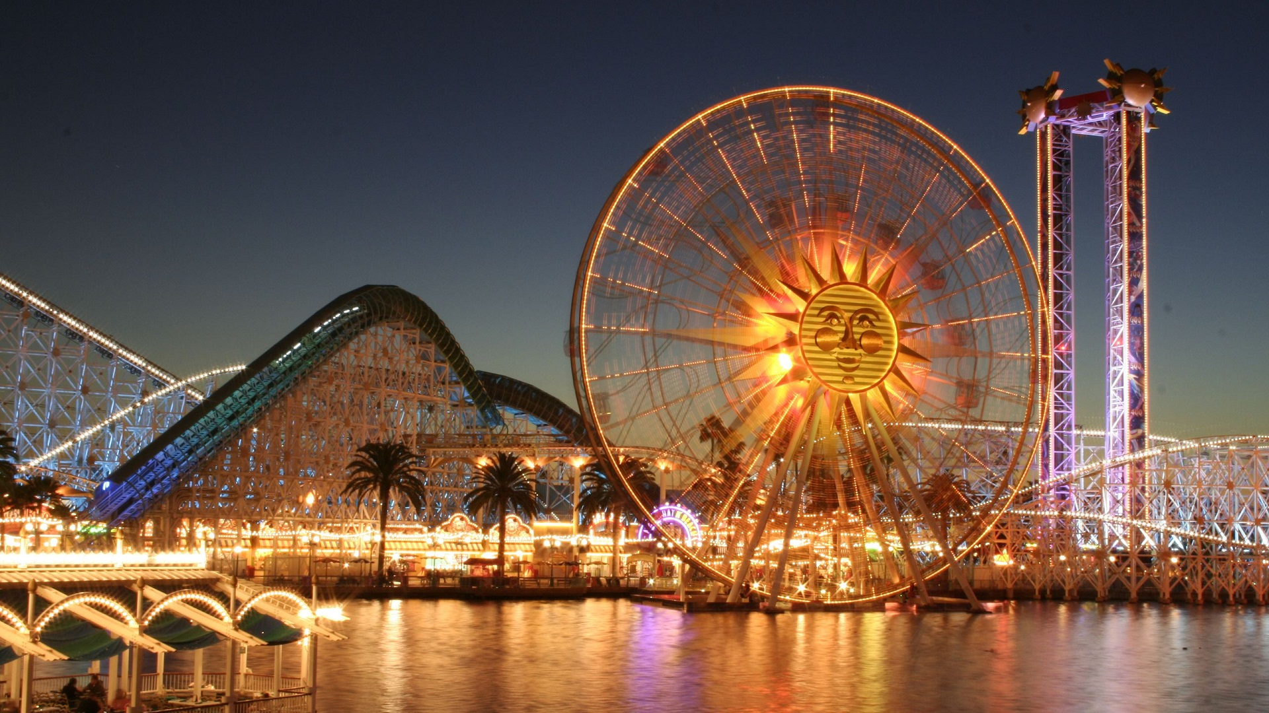
Kinematics
Uniform Circular Motion

Slide 2
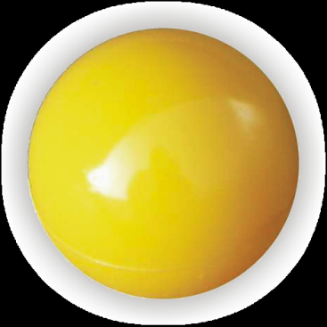
Circles
Circle- A two dimensional symmetrical polygon with no vertices. Area = πr²
Sphere- A three dimensional symmetrical polygon with no vertices. Volume = (4/3)πr³
Circular- Of, pertaining to, or containing circles.
Both circles and spheres are circular.
A sphere contains an infinite number of circles.
Circle:
Sphere:
(not a circle)

Slide 3
Uniform Circular motion
Period- The time required to complete one cycle.
In equations: T
Metric unit: s
Uniform circular motion- The motion of an
object traveling at a constant speed on a circular path.
Mathematically, the tangential speed of an object traveling in circular motion is related to its period by:

Slide 4
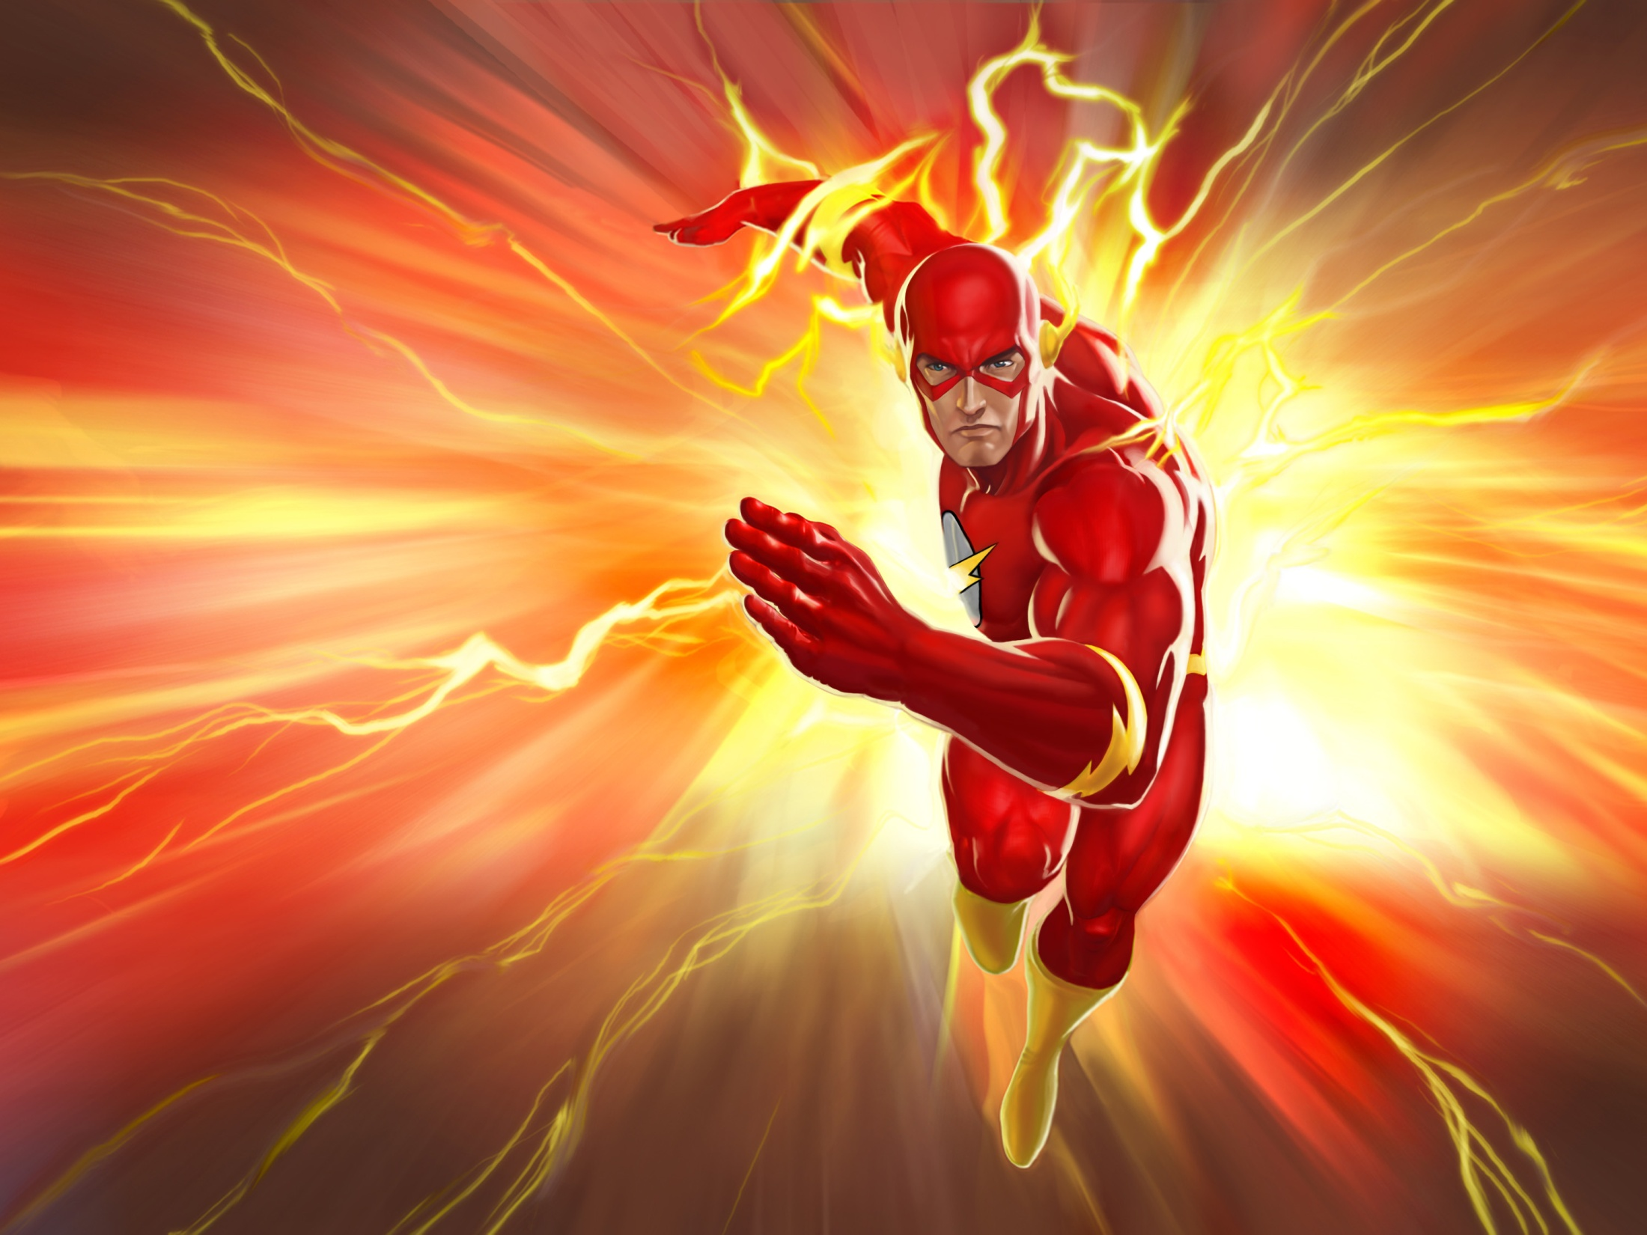
Period example
Example Problem: A jogger runs around a circular path 3 times in 9s.
The circumference of the jogger’s path is 333m.
How fast was the jogger running?

Slide 5
Period example
What is the objective?
What is given?

Slide 6
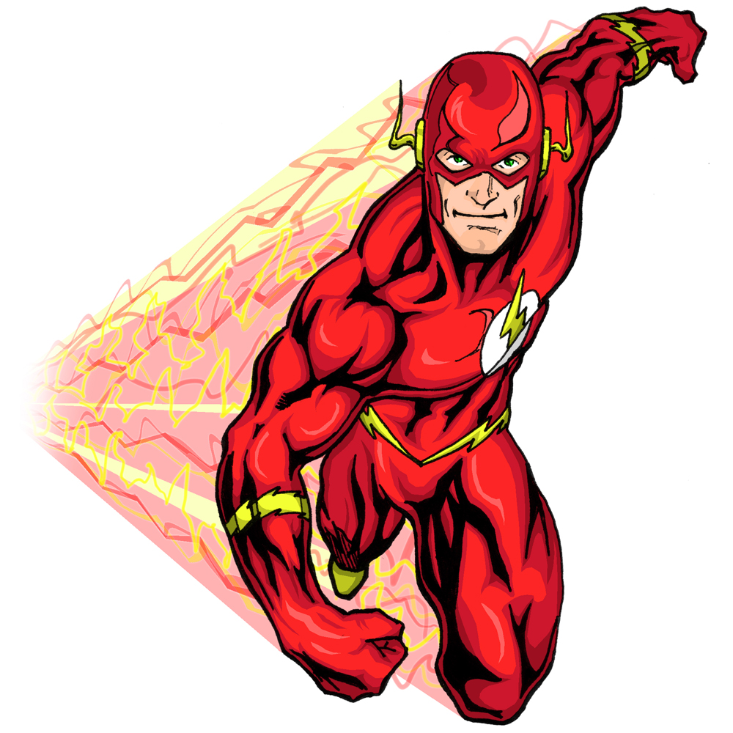
Period example
Useful Equations:
Using algebra to create a mathematical sentence for this situation.
Lastly, we calculate a numerical result.

Slide 7
Dynamics
Uniform Circular Motion

Slide 8
Uniform Circular motion
Centripetal Acceleration- The acceleration
vector that points towards the center of
curvature.
In equations: a_{c}
Metric unit: m/s²
Centripetal Force- The sum of the forces in the radial direction.
In equations: F_{c}
Metric unit: N

Slide 9
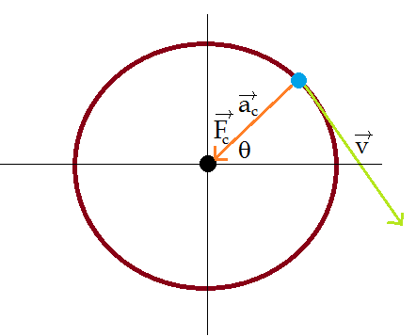
Uniform Circular Motion

Slide 10
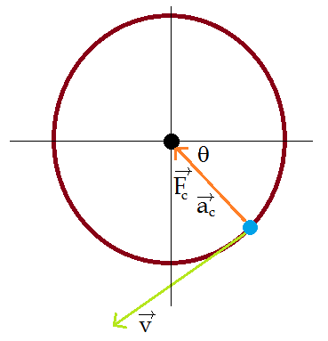
Uniform Circular Motion

Slide 11
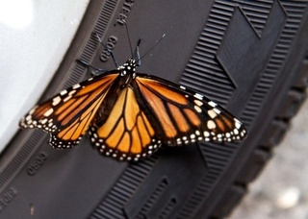
Centripetal Acceleration Example
It takes Josh 30min to ride a bike at a constant velocity for 500m.
If an insect is riding on one of the wheels which have a radius of 0.25m, what is the insect’s centripetal acceleration?

Slide 12
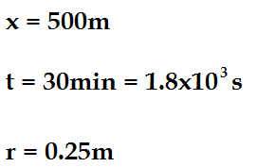
Centripetal Acceleration Example
What is the objective?
What is given?

Slide 13
Centripetal Acceleration Example
What equations are relevant?
Using algebra, we then create a mathematical expression describing this situation:

Slide 14
Centripetal Acceleration Example
Finally, we can insert the numbers:

Slide 15
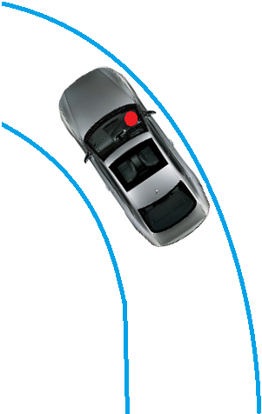
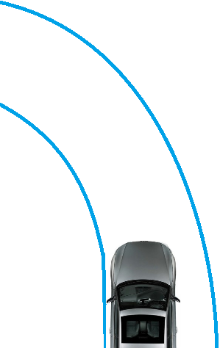
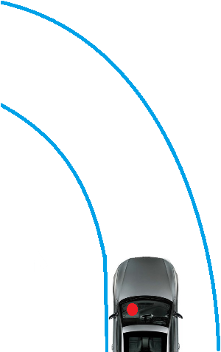
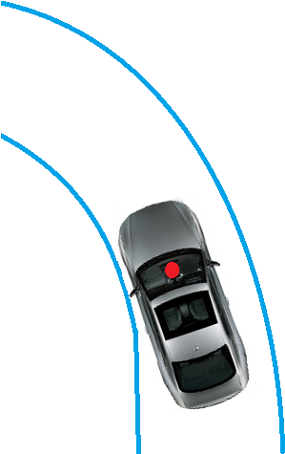

Slide 16
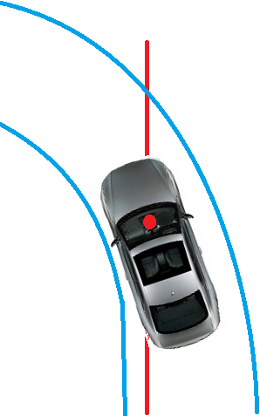
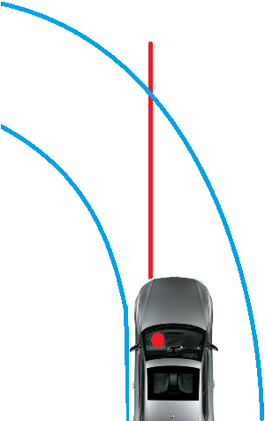
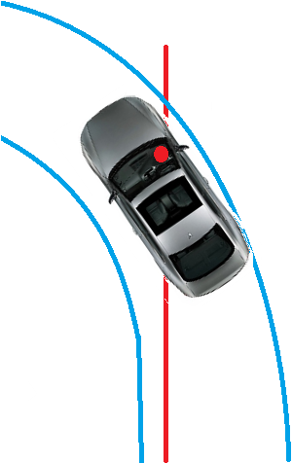

Slide 17
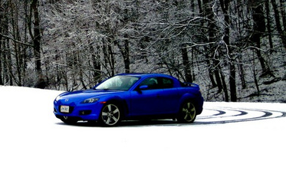
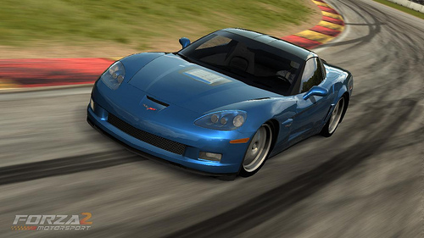
Centripetal Force Example
At what maximum speed can a car safely negotiate a horizontal turn with a radius of 51m in dry weather where the coefficient of static friction = 0.95 and in icy weather where the coefficient of static friction = 0.1 ?

Slide 18
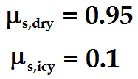
Centripetal Force Example
What are the objectives?
What is given?

Slide 19
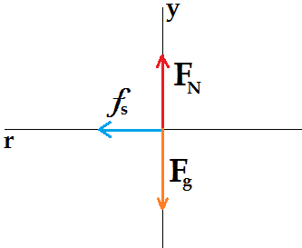
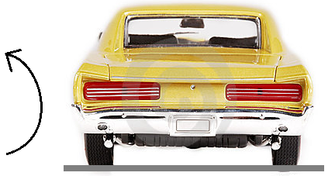
Centripetal Force Example
Due to us dealing with forces, drawing a free body diagram can be useful.

Slide 20
Centripetal Force Example
What equations are useful in this situation?
What equations can we create from our free body diagram?

Slide 21
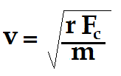
Centripetal Force Example
Now to use our algebra skills:

Slide 22
Centripetal Force Example
Now to solve for a numerical result:
Conclusion: Drive slower on the ice.

Slide 23
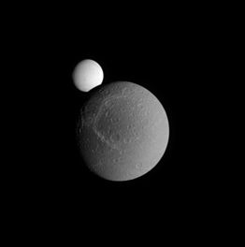
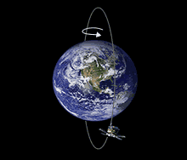
Satellites in Circular Orbits
Satellite- An object that orbits a planet.
Artificial satellites are manmade objects such GPS or radio signal satellites.
Moons are natural satellites.

Slide 24
Satellites in Circular Orbits
The speed of the orbiting satellite can be related to the radius of the orbit by:
Where G is Newton’s gravitational constant:
G = 6.67x10⁻¹¹ m³/kgs²
And M_{E} is the mass of the Earth:
M_{E}= 5.97x10²⁴ kg

Slide 25
Satellites in Circular Orbits
The period of the orbiting satellite can be related to the radius of the orbit by:
Where G is Newton’s gravitational constant:
G = 6.67x10⁻¹¹ m³/kgs²
And M_{E} is the mass of the Earth:
M_{E}= 5.97x10²⁴ kg

Slide 26
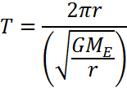
Satellite Example
Show how you can get from the Satellite tangential velocity equation to the satellite period equation algebraically.

