Slide 1
Kinematics
Velocity

Slide 2
Changing Position
Position- An object’s location in relation to some point of reference. This is a scalar quantity.
In equations: x
Base Metric unit: m (meters)
Displacement- A vector that points from an object’s initial position (x_{i} or x_{o}) to its final position (x_{f} or x). Its magnitude is the shortest distance between these two points.
In equations: ∆x
Base Metric unit: m

Slide 3
Changing Position

Slide 4
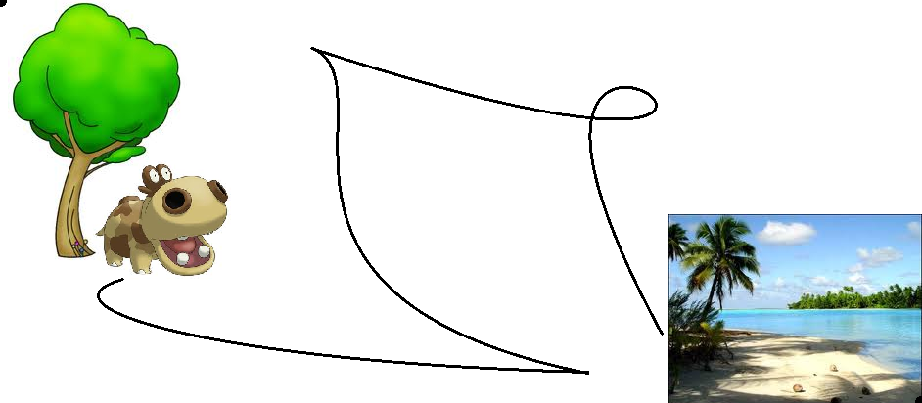
Changing Position

Slide 5
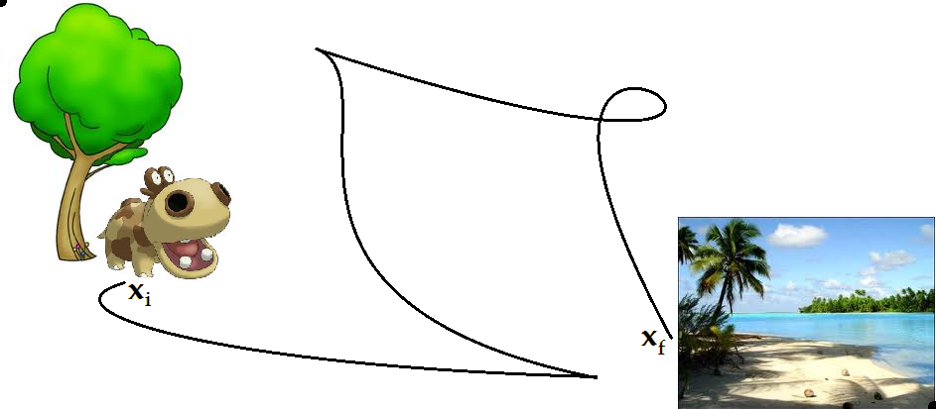
Changing Position

Slide 6
Changing Position

Slide 7
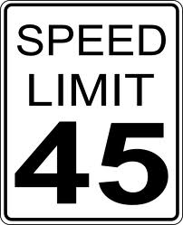
Speed vs. Velocity

Slide 8
Speed vs. Velocity
Speed- The change in an object’s position over some change in time.
Speed is a scalar quantity.
This means speed only consists of a magnitude.
Velocity is a vector quantity.
This means velocity consists of a magnitude and a direction.

Slide 9
Speed vs. Velocity
Velocity-
Speed and direction.
The change in position (displacement) over a period of time.
In equations: v
Base Metric unit: m/s (meter per second)
On a position verse time graph, velocity is the slope.
When the position is constant, the velocity is zero.

Slide 10
Speed vs. Velocity
Where ∆t is the time passed between traveling from x_{o} to x, v is the velocity, and ∆x is the displacement.
When velocity is constant this equation gives an exact result.
When velocity is changing, this equation gives an average.
This equation only yields an accurate result when the acceleration is zero.

Slide 11
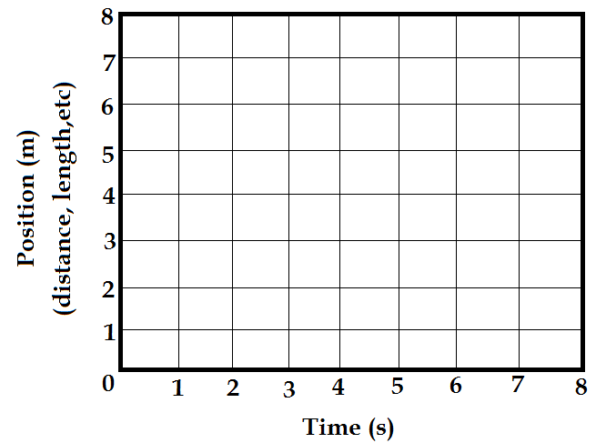
Graphing Velocity
On a position vs. time graph, velocity is the slope.

Slide 12
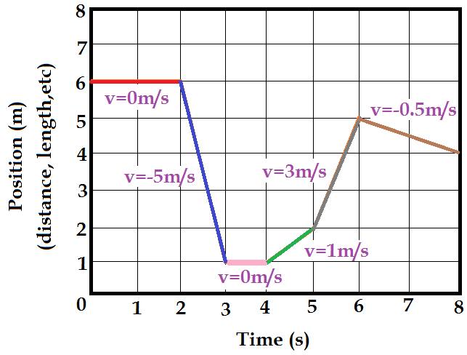
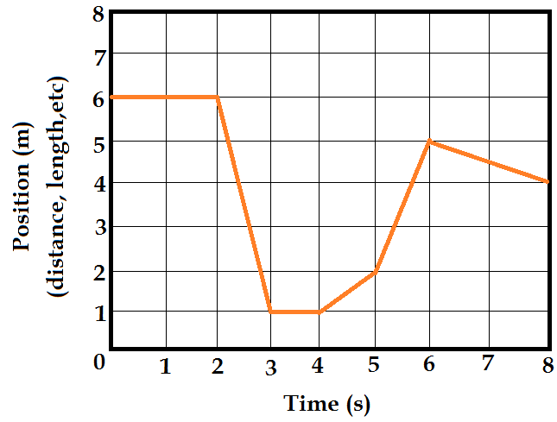
Graphing Velocity

Slide 13
Example Problem 1
An 18-year-old runner can complete a 10.0 km course with an average speed of 4.39 m/s. A 50-year-old runner can cover the same distance with an average speed of 4.27 m/s. How much later should the younger runner start in order to finish the course at the same time as the older runner?

Slide 14
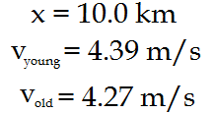
Example Problem 1

Slide 15
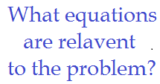
Example Problem 1

Slide 16
Example Problem 1

Slide 17
Example Problem 1

Slide 18
Kinematics
Acceleration

Slide 19
Acceleration
Acceleration-
The change in velocity over a period of time.
In equations: a
Metric unit: m/s² (meter per second squared)
On a velocity verse time graph, acceleration is the slope.
When the velocity is constant, the acceleration is zero.

Slide 20
Acceleration
Formulas
Where v_{o} is the initial velocity, v is the final velocity, a is the acceleration, and x is the distance.

Slide 21
Example Problem 2
For a standard production car, the highest road-tested acceleration ever reported occurred in 1993, when a Ford RS200 went from zero to 26.8 m/s (60mi/h) in 3.275 s. Find the magnitude of the car’s acceleration.

Slide 22
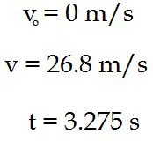
Example Problem 2

Slide 23
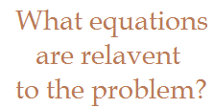
Example Problem 2

Slide 24
Example Problem 2

Slide 25
Example Problem 3
A jetliner, traveling northward (+y direction), is landing with a speed of 69 m/s. Once the jet touches down, it has 750 m of runway in which to reduce its speed to 6.1 m/s. Compute the average acceleration (magnitude and direction) of the plane during landing.

Slide 26
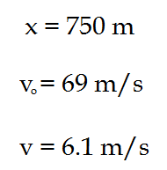
Example Problem 3

Slide 27
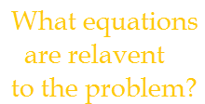
Example Problem 3

Slide 28
Example Problem 3

Slide 29
Example Problem 4
A drag racer, starting from rest, speeds up for 402 m with an acceleration of +17.0 m/s². A parachute then opens, slowing the car down with an acceleration of -6.10 m/s². How fast is the racer moving 3.50x10² m after the parachute opens?

Slide 30
Example Problem 4

Slide 31
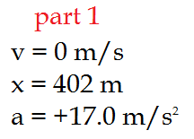
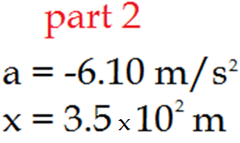
Example Problem 4

Slide 32
Example Problem 4

Slide 33
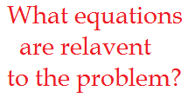
Example Problem 4

Slide 34
Example Problem 4

Slide 35
Example Problem 4

Slide 36
Example Problem 4

Slide 37
Example 5
A soccer player kicks a soccer ball up into the air at a 23º angle with a initial velocity of 12m/s. The ball experiences no horizontal acceleration.
1. How long does it take for the soccer ball to hit the ground?
2. How far away does the soccer ball land from the soccer player’s original position?

Slide 38
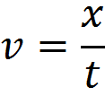
Example 5
What are we solving for?
What equations are useful?
t x
What quantities are known?
v_{o} = 12m/s
𝜃 = 23º
a_{x} = 0m/s²
a_{y} = -g = -9.8m/s²
v_{y} = 0m/s

Slide 39
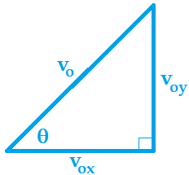
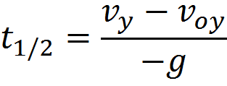
Example 5
Due to velocity being a vector, it can be broken into x and y components.
To solve for time, I will first solve for how long it takes the soccer ball to make to the top of the ball’s arc (t_{1/2}) by only concentrating on the vertical portion of the quantities (y components).

Slide 40
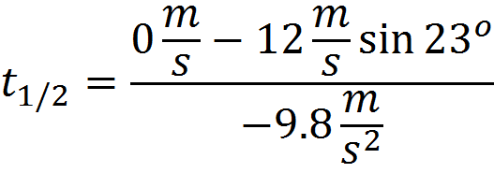
Example 5

Slide 41
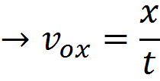
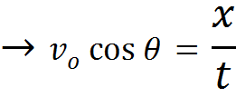
Example 5
Now to solve for the horizontal distance x, we need to use v_{ox}.
Also, we need to utilize the fact that the time t is the only quantity that is the same in both the x and y direction.

Slide 42
Example Problem 6
A train is traveling 67m/s southeast with respect to the train tracks at a -30º angle from the x-axis (east to west). A boy on the train throws a ball at a velocity of 15m/s north and 19m/s east with respect to the train.
What is the speed of the ball with respect to the train?
What is the velocity of the ball with respect to the train tracks? (Have your answer in vector notation.)

Slide 43
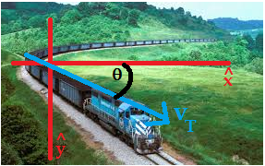
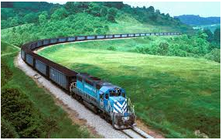
Example Problem 6
What is our objective?
v (speed) and v (velocity)
What are the known quantities?

Slide 44
Example Problem 6
First, to solve for the speed of the ball with respect to the train, all we need to do is find the magnitude of the velocity of the ball with respect to the train.

Slide 45
Example Problem 6
The velocity of the ball with respect to the train tracks is equal to the velocity of the ball with respect to the train plus the velocity of the train with respect to the train tracks.

Slide 46
Applying Calculus
Calculus allows us to find an exact result for velocity even when velocity is changing, we call this the Instantaneous Velocity.
Velocity is the first derivative of position with respect to time.
Acceleration is the first derivative of velocity with respect to time.
Acceleration is also the second derivative of position with respect to time.
This is primarily of use when either an object’s position, velocity, and/or acceleration is given as a function.

Slide 47
Example Problem 7
A particle moves along a path with a position (in meters) that can be determined by the function (where t is in seconds) :
What is the position of the particle when t = 3?
What is the velocity of the particle when t = 3?
What is the acceleration of the particle when t = 3?
At what time(s) is the velocity zero?
What units must be accompanying the number 4 in the function?

Slide 48
Example Problem 7
First, we’ll solve for the position of the particle after 3s have passed.
Next, we’ll solve for the velocity of the particle after 3s have passed.
Now we’ll solve for the acceleration of the particle after 3s have passed.

Slide 49
Example Problem 7
Next, we’ll solve for the possible time(s) when the velocity equals zero.
As it would turn out, we do not actually need to solve for the time because there is no possible positive real value of t which would result in v = 0.
Now let’s take a look at the original function and determine the units of 4.
If x on the left hand side of the equation is in meters, then every term must be in meters.
In conclusion, the units of 4 must be m/s³ in order for the equation to balance.

