Slide 1
Welcome !
Physics 231

Slide 2
Scientific Method
Physics- The study of matter and energy and their interaction between each other.
Physicists analyze nature to understand how the universe behaves.
This is done in a systematic way known as the scientific method which relies on facts, laws, hypothesizes, and theories.
Hypothesis are formed using known facts, tested via experimentation, analyzed via known laws, and theories are ultimately formed.

Slide 3
Scientific Method
Fact- A truth statement void of any predictive capability.
Law- A pattern in nature capable of being described mathematically.
Hypothesis- An educated guess based on observations conducted prior to experimentation.
Theory- An educated analysis based on evidence conducted after many experimentations.
Theories do not become facts or laws.

Slide 4
Scientific Method
In order for a hypothesis to become a theory, many experiments must be conducted by many people in various conditions all which yield equivalent results.
A theory can be thought of as a model based on evidence and experimental data that explains the relationship between facts and provides predictive insight.

Slide 5
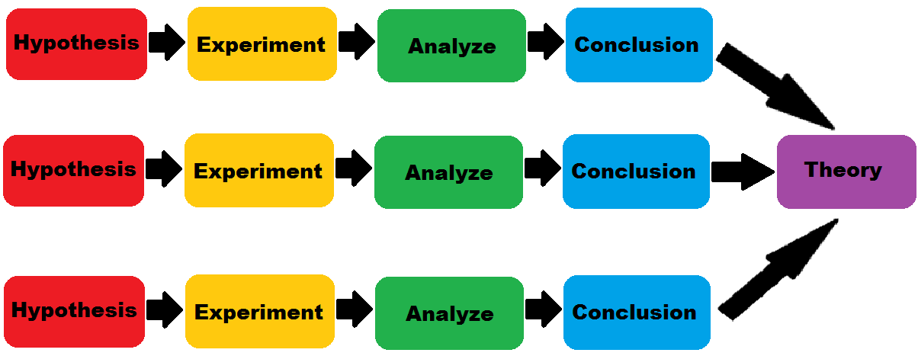
Scientific Method

Slide 6
General Information
Examples of established theories in physics:
Photoelectric Theory
Quantum Field Theory
The Theory of Thermodynamics
The Theory of Relativity
The Wave-Particle Duality Theory of Light
Electromagnetic Theory
Gravitational Theory

Slide 7
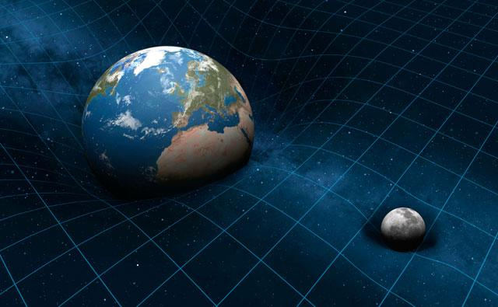
General Information
Gravitational Theory- The study of the natural phenomenon of all physical bodies to be attracted to one another.
Quantity- A measurable property.

Slide 8
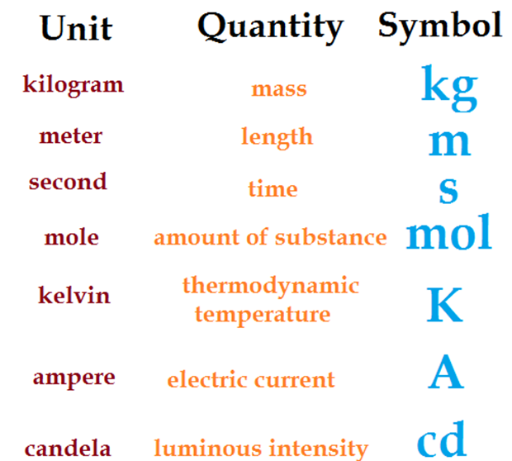
S. I. Base Units

Slide 9
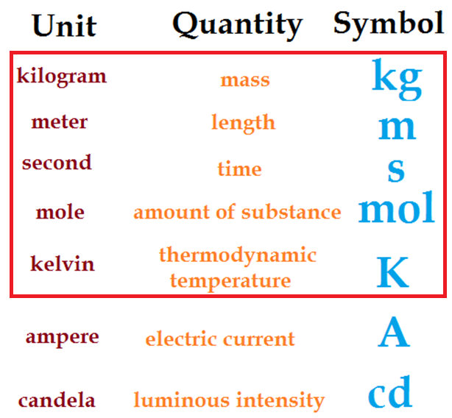
S. I. Base Units

Slide 10
General Information
The International System of Units (S.I.), commonly referred to as the metric system is used by all branches of science including physics in nearly every country.
SI prefixes in everyday use
Text | Symbol | Factor
tera | T | 1000000000000
giga | G | 1000000000
mega | M | 1000000
kilo | k | 1000
hecto | h | 100
(none) | (none) | 1
centi | c | 0.01
milli | m | 0.001
micro | μ | 0.000001
nano | n | 0.000000001

Slide 11
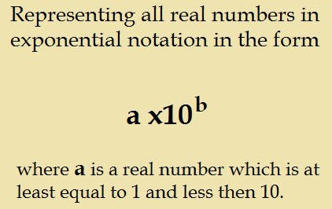
Scientific Notation

Slide 12
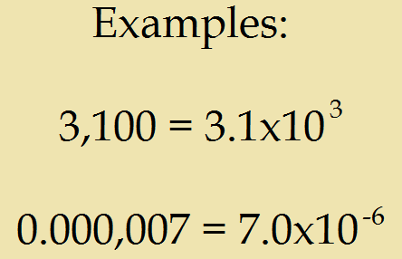
Scientific Notation

Slide 13
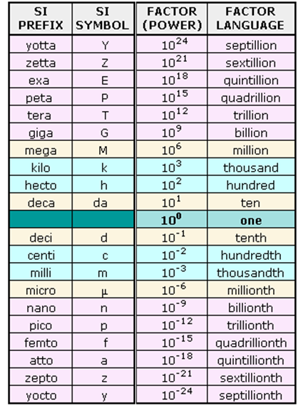

Slide 14
Algebra
Algebra is the study of operations and is used to refer to unknown or changing quantities as symbols instead of numbers.
Algebra also allows us to manipulate the relationships between these variables in order to discover new relationships.

Slide 15
Algebra

Slide 16
Trigonometry
Trigonometry allows us to describe triangles.
Trigonometry also allows us to describe any property of matter or energy that undergoes repetitive periodic motion in terms of an ever changing angle on a right triangle within a unit circle.

Slide 17
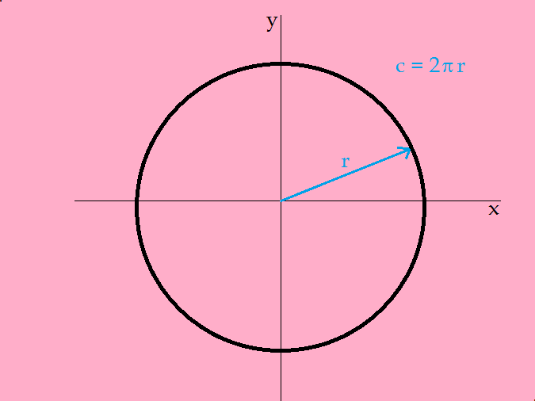
Trigonometry

Slide 18
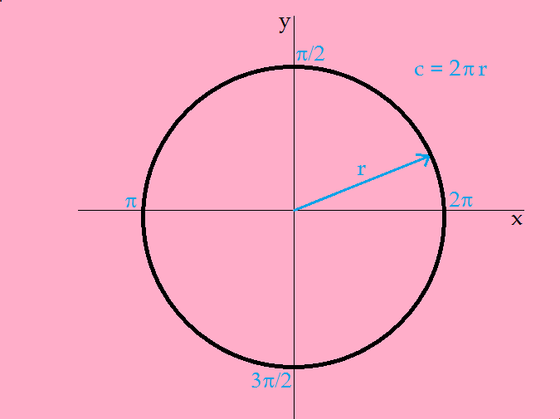
Trigonometry

Slide 19
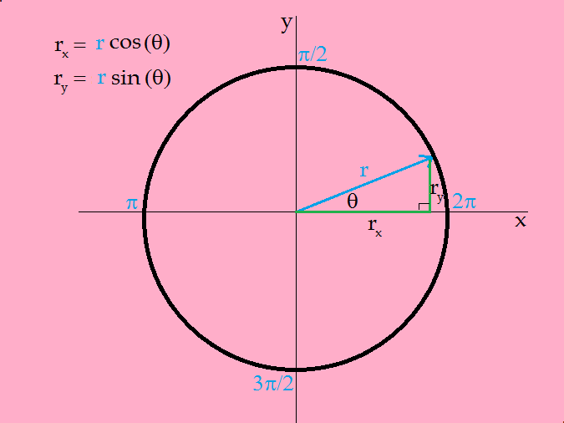
Trigonometry

Slide 20
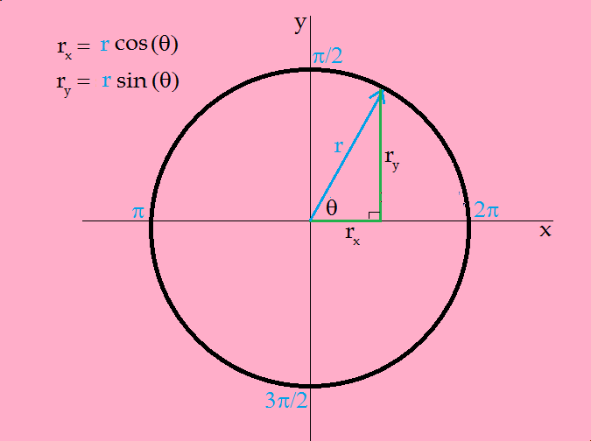
Trigonometry

Slide 21
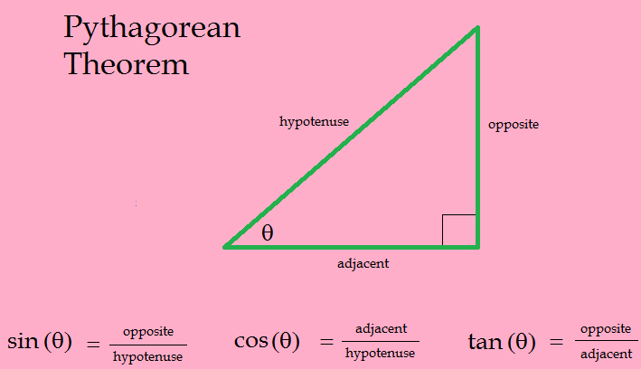
Trigonometry

Slide 22
Calculus
Calculus is the study of change.
Calculus allows us to deal with infinities in nature.

Slide 23
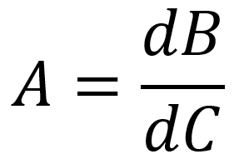
Calculus
When solving for A, take the derivative of B with respect to C.
When solving for either B or C, the integral of A must instead be taken.

Slide 24
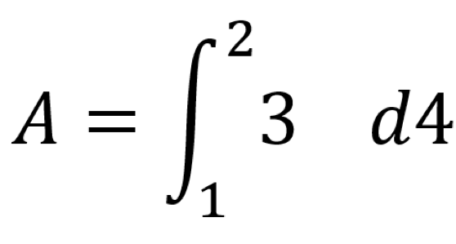
Calculus
When integrating, keep these tips in mind:
What’s in location 1 and 2 must be the minimum and maximum of your variable.
What’s in location 4 must be the variable in question that you’ll be integrating with respect to.
Lastly, the function in location 3 should contain the same variable declared in location 4 and no other.

Slide 25
General Information
The practical purpose of physics is to be able to accurately and literally predict the future.

