Slide 1
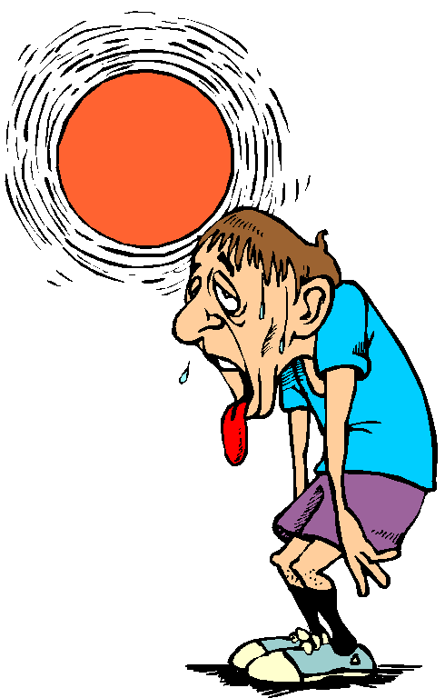
Thermodynamics
Heat

Slide 2
Heat
Heat- Thermal energy that flows from higher temperature objects to lower temperature objects.
In equations: Q
Metric Unit: J
Heat flows into an object if the temperature of the object is raised.
Heat flows out of an object if the temperature of the object is lowered.

Slide 3
Heat
The amount of heat lost or gained is directly proportional to the object’s mass and change in temperature.
Specific heat capacity- A material specific constant pertaining the material’s ability to hold heat.
In equations: c
Metric unit: J/(kg Cº) = J/(kgK)

Slide 4
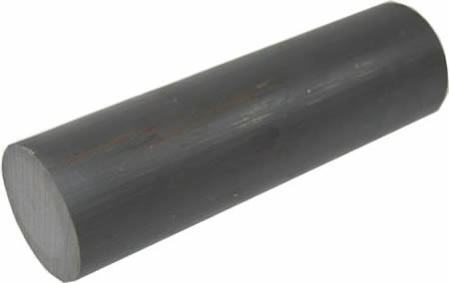
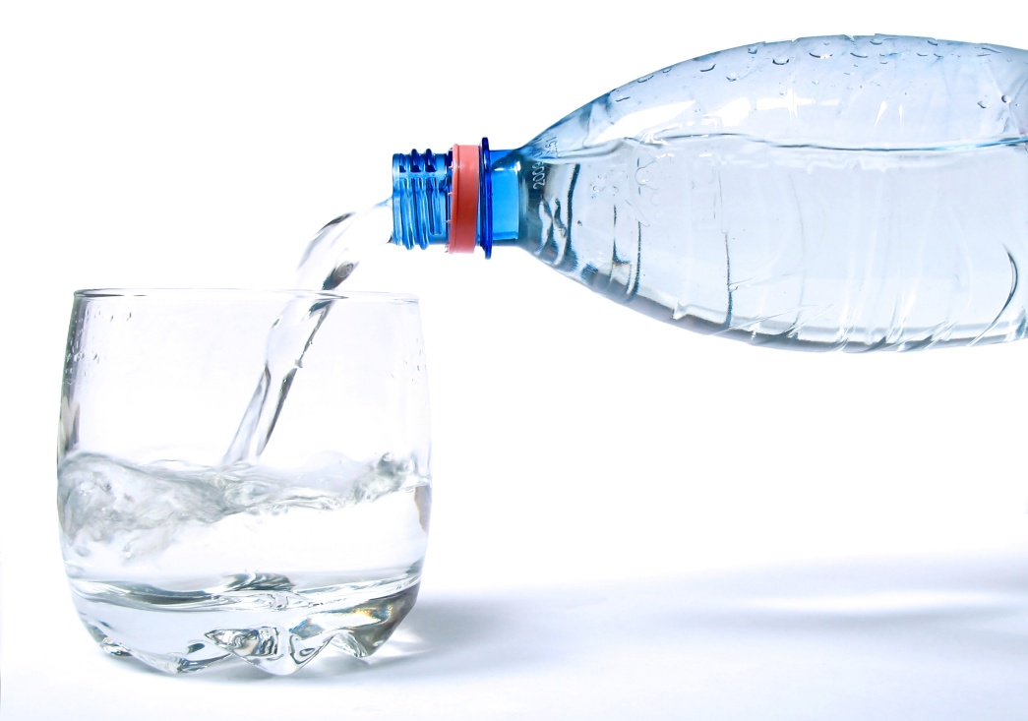
Specific Heat Example
A 10g iron bar at 80 ºC is dropped into 7x10⁻⁵m³ of water which is initially at 25 ºC.
The specific heat of water is 4.184x10³J/kgCº.
The specific heat of iron is 0.46x10³ J/kgCº.
What is the final temperature?

Slide 5
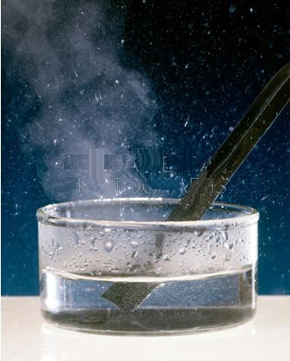
Specific Heat Example
What are we solving for?
T_{f}
What quantities are known?
m_{i} = 10g = 0.01 kg
V_{w} = 7x10⁻⁵ m³
c_{w} = 4.184x10³ J/kgCº = 4.184x10³ J/kgK
c_{i} = 0.46x10³ J/kgCº = 0.46x10³ J/kgK
T_{oi} = 80 ºC = 353.15 K
T_{ow} = 25 ºC = 298.15 K
ρ_{w} = 1000 kg/m³

Slide 6
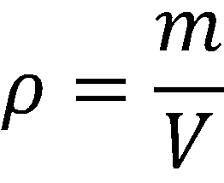
Specific Heat Example
What are some relevant equations?
Now for some algebra:

Slide 7
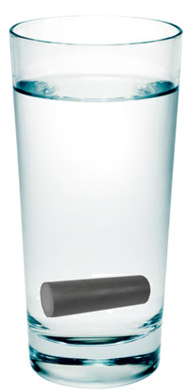
Specific Heat Example

Slide 8
Phase Change
Phase Change – When a substance changes what state of matter it is in.
The States of Matter
Solid – When the molecules that make up the substance vibrate in place due to strong bonds.
Liquid – When the molecules that make up the substance have weak bonds and flop around.
Gas – When the molecules that make up the substance have no bonds and attempt to fill their container.
Plasma – When the molecules that make up the substance undergo fission and fusion continuously.

Slide 9
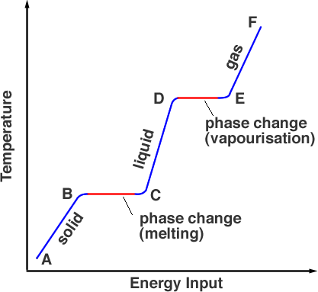
Phase Change
It takes energy in the form of heat to change the temperature of an object.
It also takes energy in the form of heat to change the state of matter from one phase to another.

Slide 10
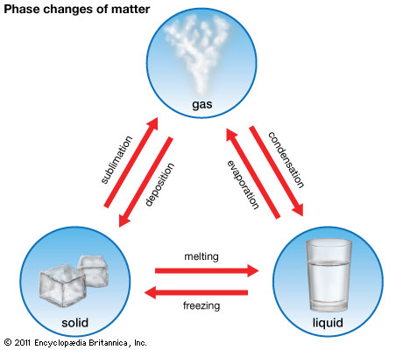
Phase Change
Melting- solid to liquid.
Freezing- liquid to solid.
Condensation-gas to liquid.
Evaporation- liquid to gas.
Sublimation- solid to gas.
Deposition- gas to solid.

Slide 11
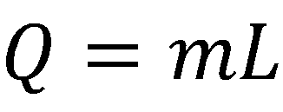
Phase Change
The energy it takes to phase change is directly proportional to the object’s mass and latency.
Latent Heat- A material specific constant pertaining to the material’s ability to release and absorb heat.
In equations: L
Metric unit: J/kg

Slide 12
Phase Change
There are three types of latent heat.
The latent heat of fusion, L_{f} refers to the change between solid and liquid phases.
The latent heat of vaporization, L_{v} refers to the change between liquid and gas phases.
The latent heat of sublimation, L_{s} refers to the change between solid and gas phases.

Slide 13
Phase Change Example
The latent heat of vaporization for apple juice is 2.26x10³ kJ/kg and the specific heat of apple juice is 3.86x10³ J/kgCº.
Apple Juice boils at about 370K.
How much heat does it take to heat 0.8kg of apple juice up from 280K to 400K ?

Slide 14
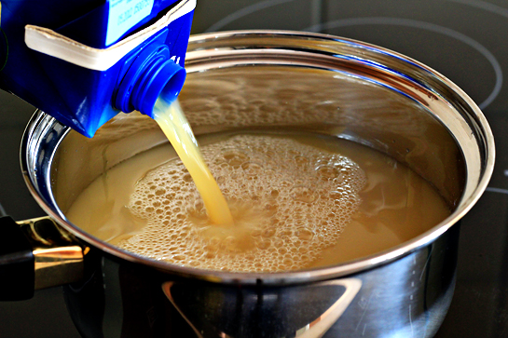
Phase Change Example
What are we solving for?
Q
What quantities are known?
c = 3.86x10³ J/kgCº = 3.86x10³ J/kgK
L_{v} = 2.26x10³ kJ/kg = 2.26x10⁶ J/kg
m = 0.8kg
T_{o} = 280K
T_{f} = 400K
T_{b} = 370K

Slide 15
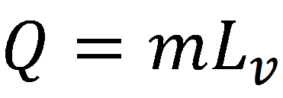
Phase Change Example
What equations are useful?
How can we combine these equations for this situation?
Energy needed to phase change from liquid to gas.
Energy needed to get to the final temperature.
Energy needed to get to the boiling point.

Slide 16
Phase Change Example

Slide 17
The Laws of Thermodynamics
The 1st Law
The energy in an isolated system can not be created or destroyed, but transferred.
The 2nd Law
The entropy of an isolated system always increases.
Entropy – The amount of disorder in a system.
In equations: S
Metric Unit: J/K
The 3rd Law
No substance can be at or below absolute zero.

