Slide 1
Testing for Validity with Venn Diagrams
A method for Categorical Arguments

Slide 2
Categorical Arguments
In contrast with the kind of arguments we’ve considered so far, categorical arguments are valid by virtue of the relationship between the groups involved.
Consider the argument:
(1) If Al gets the job then Barb won’t and I think that Barb will get it. So, Al won’t get it.
That argument is valid (can you show that it is with a truth table?) because of the way the SENTENCES are related. ‘Al gets the job’ and ‘Barb won’t’ could be replaced with any declarative sentences and the argument would still be valid.
Now consider a different argument:
(2) All consumers are expected utility maximizers and all expected utility maximizers are perfectly rational. So all consumers are perfectly rational.
That argument is valid because of the way the CATEGORIES are related. ‘Consumers’, ‘expected utility maximizers’ and ‘perfectly rational (people)’ could be replaced with any categories and the argument would still be valid.
Arguments of the first sort are SENTENTIAL and arguments of the second kind are CATEGORICAL. We check the former for validity with truth tables and we check the latter with Venn diagrams.

Slide 3
Four Categorical Sentences
All X are Y. (e) No X are Y.
(i) Some X are Y. (o) Some X are not Y.
The sentences connected by blue arrows are contradictory; if one is true then the other is false. It was long thought that (a) implied (i) and that (e) implied (o), but now that view is commonly rejected.

Slide 4
Usefulness of the Four Sentence Types
A huge variety of sentences can be rewritten in one of the four forms. So, many arguments can be evaluated as categorical even if they aren’t obviously categorical at first glance. Some examples follow:
If something is X then it is Y. Every X is Y. Xs are all Ys. Nothing is X but not Y.
(e) If something is X then it isn’t Y. Every X is not Y. Nothing is both X and Y.
(i) There are Xs that are Ys. Some things are both X and Y. At least one X is Y.
(o) There are Xs that are not Ys. Some things are X but not Y. At least one X is not Y.

Slide 5
Representation With Circles
Let a circle represent a category. Then you can make sense of representing ‘All X are Y’ by putting an circle for X INSIDE a circle for Y. That would show that there aren’t any Xs outside the group of Ys.
Since there’s nothing special about the shape we use, you shouldn’t object if the inside region (the X region) was a football-shaped and off to one side.
X
Y
X
Y

Slide 6
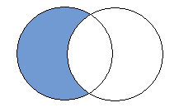
Representation on a Venn Diagram
Because it will be useful to have a uniform starting shape for all four sentence types, we’ll represent the (a) sentence (All X are Y) this way:
The shaded portion of the X circle is empty. Read the diagram to say that the part of the X circle that’s outside the Y circle contains nothing. The only portion of the X circle that might contain something is the portion inside the Y circle. So think of it as being equivalent to the bottom diagram on slide five.
X
Y

Slide 7
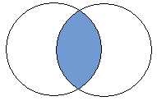
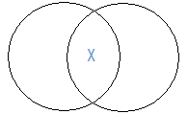
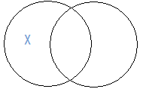
The Other Three Sentences
X
Y
(e) No X are Y.
(i) Some X are Y.
(o) Some X are not Y.
Think of the little ‘x’ as saying that there is something in a region. So, shading a region says it has no contents and putting an ‘x’ in a region says just the opposite—that it has contents.
From the four diagrams you can see clearly what is represented on slide three: the (a) and (o) sentences are contradictory and the (e) and (i) sentences are contradictory.
X
Y
X
Y

Slide 8
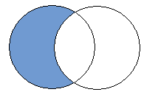
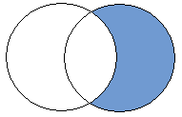
Checking Validity
Consider this argument: All of Madoff’s later investors were ruined by his scheme. So, everyone ruined by his scheme was a later investor.
The argument has this form:
All L are R
So all R are L.
The premise looks like this on a Venn Diagram:
The conclusion looks like this:
Since the premise could be true without the conclusion being true—it is consistent with the premise that there be something in the right crescent—the argument is invalid.
L
R
L
R

Slide 9
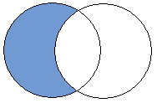
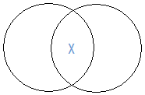
Another Example
Some of Madoff’s new friends were ruined by his scheme since all of Madoff’s new friends were ruined by his scheme.
Here’s the form:
All F are R
So some F are R
The premise on a Venn Diagram:
The conclusion on a Venn diagram:
Since the representation of the conclusion is not contained within the representation of the premise—which it would be if the premise guaranteed the conclusion—the argument is invalid. This might seem strange at first since the argument seems valid but our method says it isn’t. That’s because we don’t treat (a) (or (e)) sentences as saying that there is something in some region, but only as saying that some region is empty. This argument could have true premises and a false conclusion if Madoff has no new friends (if the entire F circle is empty).
F
R
F
R

Slide 10
Three Circle Venn Diagrams
To test for validity on any Venn diagram you represent the premises and check to see if the conclusion is contained already on the diagram. On a two circle Venn Diagram for a single premised argument that’s really just checking to see whether the representation of the premise is identical to the representation of the conclusion.
On a three circle Venn Diagram for a two premised argument with three categories, the test isn’t quite as easy. You represent the premises and check to see if putting the conclusion on the diagram would be redundant.

Slide 11
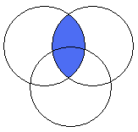
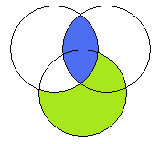
Representing (a) and (e) Sentences
To represent ‘no Accountants are Boring’ on a three circle Venn Diagram, just ignore the third circle and do it as you would on a two circle diagram.
To represent ‘All CPAs are Accountants’ again ignore the third circle. Here’s what it looks like (in green) on the diagram that already contains ‘no A are B’ (in blue):
The bottom diagram shows that the conclusion ‘no B are C’ follows validly from the premises since the overlap between B and C was filled in by the two premises.
A
B
C
A
B
C

Slide 12
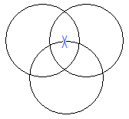
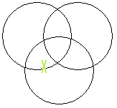
Representing (i) and (o) Sentences
For the sentences with existential import (that say that there is something somewhere) you cannot ignore the third circle. The region that would have contained the ‘x’ on a two circle Venn Diagram has been divided into two parts and we must indicate on the diagram our uncertainty about which of those sections the ‘x’ falls into. We’ll do that by putting the x on the line of the circle we’re unsure about (the one not mentioned in the premise).
Some A are B.
Some C are not B.
The ‘x’ goes on the line of the letter not mentioned.
A
B
C
A
B
C

Slide 13
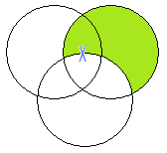
Putting Them Together
Consider the argument:
Some A are B.
All B are C.
So, some B are C.
To check for validity, represent the premises on a Venn Diagram and then look to see if the conclusion is contained on the diagram.
Since the first premise puts an ‘x’ on a line (meaning the ‘x’ might be on either side of the line) and the second premise says that one side of the line is empty, move the ‘x’ to the only open side of the line.
A
B
C
A
B
C
An ‘x’ in the middle means that
There is something in the overlap between B and C. So the conclusion must be true if the premises are. So the argument is valid.

Slide 14
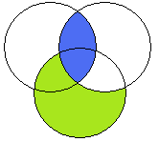
An Example
No merchants want to lose customers. Everyone who is openly unfair wants to lose customers. So no merchants are openly unfair.
In standard form:
No M are W.
All O are W.
No M are O.
Symbolize the premises:
M
W
O
Then look for the conclusion. Since the football between M and O is shaded and that’s what the conclusion requires, the argument is valid.

Slide 15
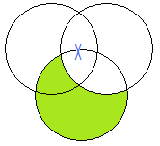
Another Example
Some pyramid schemes are illegal. Everything that Madoff did was illegal. So some of what Madoff did was a pyramid scheme.
In standard form:
Some P are I.
All M are I.
So, some M are P.
P
I
M
For the conclusion to be required by the premises there would have to be an ‘x’ in the overlap between M and P. The ‘x’ that’s on the M boundary might be in that region but it might not; we’re not sure—that’s why we put it on the boundary. So the premises don’t guarantee the conclusion and this argument is invalid.

